Slide 1

COVID-19 Hospitalization Surge Forecasting
Hybrid SEIR + Statistical Correction Model
Roschelle Dsouza
Notes:
Today I'll walk you through a hybrid forecasting model built to predict COVID-19 hospitalization surges in Dallas County, Texas.

Slide 2
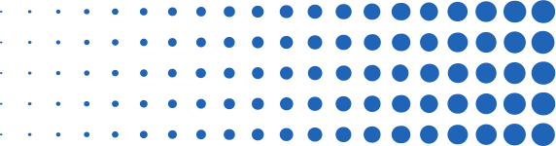
Core Issue + Solution
Traditional hospital capacity models assumed steady-state demand — they were not built for exponential surges. COVID-19 exposed this gap: systems were overwhelmed before planners could react.
The solution: combine the mechanistic logic of epidemiological models with data-driven correction to produce actionable, uncertainty-aware forecasts
Audience: hospital administrators and public health agencies who need lead time to act
Notes:
The core problem this project addresses is one of timing and visibility. Hospital systems are designed for predictable, steady demand — COVID shattered that assumption repeatedly. By the time surge signals were obvious in the data, it was often too late to staff up, source PPE, or activate overflow protocols. Our goal was to build a model that gives decision-makers 1 to 4 weeks of lead time, with honest uncertainty bounds so they can plan proportionally to risk rather than reacting to confirmed crises.

Slide 3

Data Sources
HHS Protect
HHS Protect COVID hospitalization dataset (healthdata.gov), filtered to Dallas County, TX (FIPS: 48113)
US Census
Population denominator: Dallas County population of 2,613,539
CDC Covid Data API
Vaccination data: CDC API. Series completion percentage by FIPS, forward-filled weekly
Notes:
I pulled from three main sources. The backbone is the HHS Protect dataset, which reports weekly hospitalization averages at the hospital level — I aggregated these up to the county level. Vaccination rates came from a CDC API by FIPS code, and case counts from a Texas state-level CDC feed. A critical preprocessing step was date normalization before merging, since the three sources used different timestamp formats. I also forward-filled vaccination rates across weeks where data was sparse, and we used the county's 75th percentile of recent hospitalizations as a proxy for operational bed capacity.

Slide 4
Model Overview
Base model + Correction Layer
SEIR Model
Gradient Boosting Correction Layer
Produces a biologically grounded forecast of infectious individuals, scaled to hospitalizations
Trained on SEIR residuals, incorporating lagged case counts
Final output: corrected point forecast + 90% prediction intervals, widening over the forecast horizon
Beta (transmission rate) estimated via bounded scalar optimization (scipy minimize_scalar), calibrated independently per wave period across four defined wave windows
Effective beta adjusted for vaccination rate using: β_eff = β_raw × (1 − 0.85 × vax_rate)
Notes:
Think of the architecture as a two-layer system. The first layer is a physics-based model — SEIR — that encodes what we know about how diseases spread. It gives us a structurally sensible baseline. But SEIR alone doesn't capture everything: local reporting lags, behavioral changes, or policy effects leave systematic residuals. The second layer — a linear regression — learns those residuals from historical data and corrects the SEIR output. This hybrid approach outperforms either model alone, which we'll see in the evaluation slide.

Slide 5
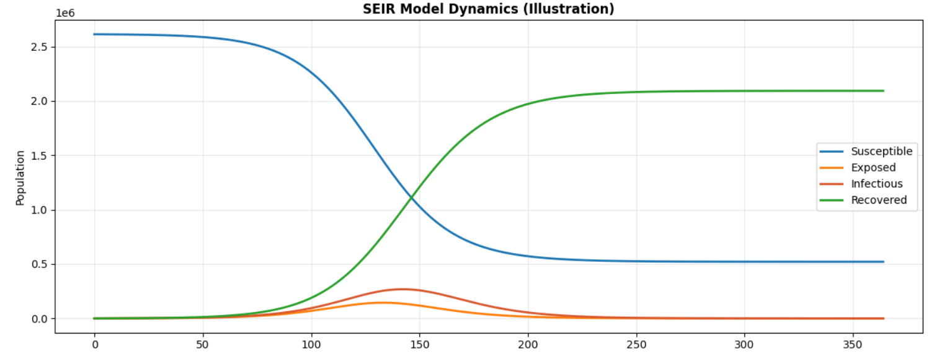
SEIR Model
Estimated transmission rate β through calibration, minimizing error against observed hospitalizations
Fit a separate β for each COVID wave period to reflect changing transmission patterns
Set initial conditions from early hospitalization data and scaled SEIR output to match observed levels
Adjusted effective transmission using vaccination coverage and assumed 85% vaccine effectiveness
Notes:
One of the assignment's key questions is how we estimate beta — the transmission rate — since it's not directly measured. The answer is calibration: we treat beta as an unknown and search for the value that minimizes prediction error on the training data. scipy's minimize_scalar does this efficiently. A related question the assignment raises is whether to use a hierarchical model across counties given population size differences. Here we model Dallas County in isolation, but a production system would absolutely want a hierarchical structure — pooling information across counties while allowing county-specific deviations. The vaccination adjustment is straightforward: a higher vax rate shrinks the effective susceptible pool, reducing transmission.

Slide 6
Correction Layer + Training
Calculated SEIR residuals: actual hospitalizations minus SEIR predictions
Trained a Gradient Boosting Regressor to predict and correct SEIR errors
Used five features: SEIR prediction, lagged cases, growth rate, and 2–3 week lagged hospitalizations
Built 90% prediction intervals using training residual standard deviation
Scaled uncertainty by √weeks ahead for multi-week forecasts
Used an 80/20 train-test split for evaluation
Notes:
The correction layer is deliberately simple — a linear regression. This is intentional. Complex correction models risk overfitting to pandemic-specific noise that won't recur. The lagged case count is a meaningful feature because COVID hospitalizations typically follow case counts by one to two weeks. The standard deviation of training residuals becomes our uncertainty estimate for the intervals. Scaling that uncertainty by the square root of the forecast horizon is a principled choice: uncertainty compounds as you project further out, and the square-root law captures that mathematically. We used an 80/20 train-test split, keeping at least 4 weeks in the holdout to evaluate the 4-week ahead horizon properly.

Slide 7
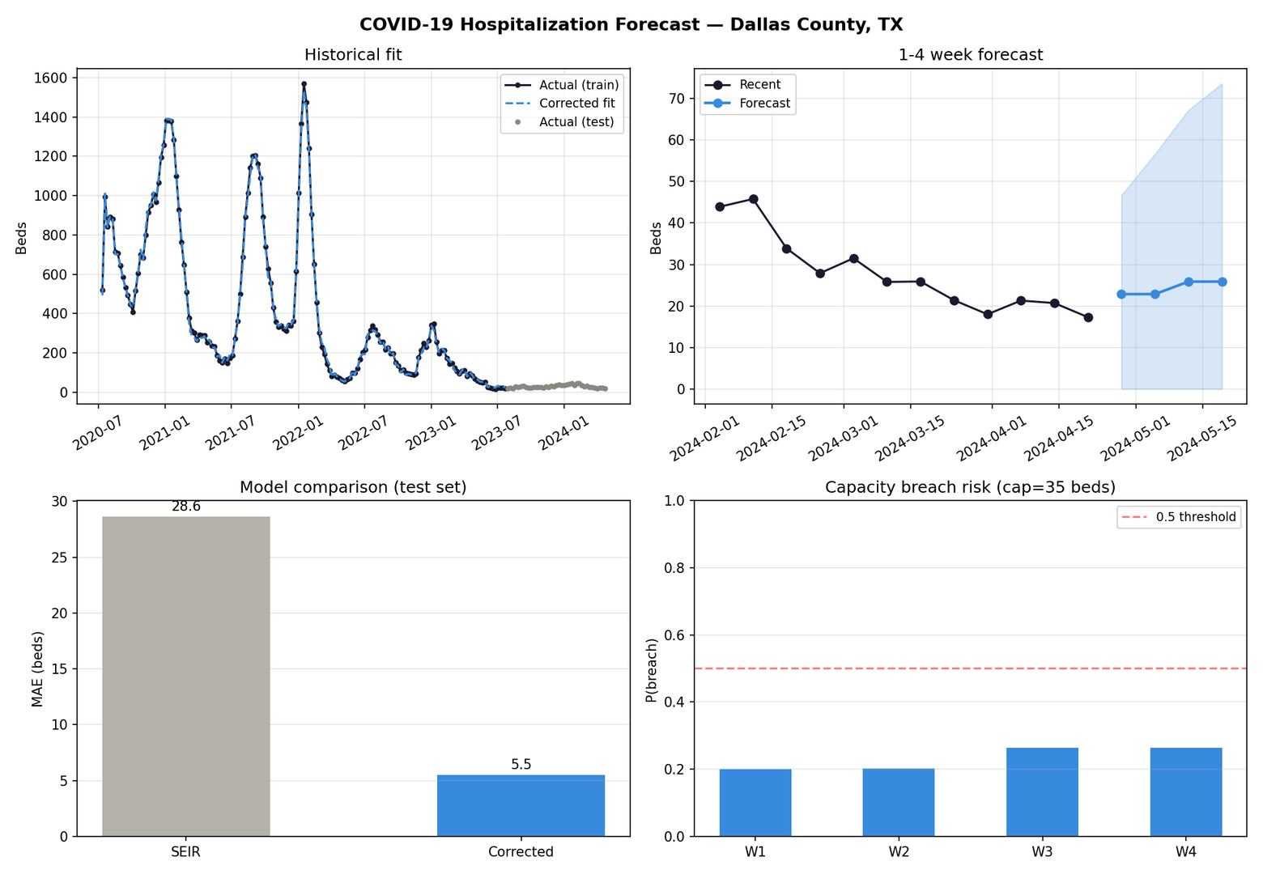
Hospitalization
Forecast
Notes:
In the top-left chart, we can see that the corrected model closely follows the historical hospitalization trends across multiple COVID waves. The model captures the major spikes in late 2020, mid-2021, and early 2022, while also matching the lower hospitalization levels seen after 2023.
The top-right chart shows the 1–4 week forecast. Recent hospitalizations were trending downward and stayed below the capacity threshold of 35 beds. The forecast predicts hospitalizations remaining relatively stable in the low-to-mid 20s, with only a slight increase by week 4. The shaded area represents the prediction interval, which widens over time because uncertainty increases further into the future.
The bottom-left chart compares model accuracy on the test set. The SEIR-only model had an MAE of about 28.6 beds, while the corrected model reduced MAE to about 5.5 beds. This shows that the correction layer substantially improved forecast accuracy by adjusting for patterns the SEIR model alone could not capture.
The bottom-right chart shows capacity breach risk using a 35-bed threshold. The predicted risk stays below the 0.5 decision threshold for all four forecast weeks, suggesting that a capacity breach is unlikely during this forecast period.
Overall, the corrected SEIR model performs much better than the baseline SEIR model and provides a more useful short-term forecast for hospital capacity planning.

Slide 8
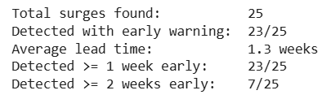
Surge Detection
Notes:
The surge detection analysis identified 25 surge events across the full Dallas County hospitalization time series from July 2020 through late 2023. A surge was defined as a greater than 50% increase in hospitalizations over any 3-week window — a threshold calibrated to capture clinically significant demand spikes rather than routine week-to-week variation.
Of the 25 confirmed surges, 23 were detectable in advance using a 15% weekly growth rate as an early warning signal, representing a 92% retrospective detection rate. The average lead time across those 23 detected surges was 1.3 weeks. Seven surges produced 2 or more weeks of early warning, representing the scenarios where the model would have given administrators the most time to act.
The two undetected surges are worth examining — these are cases where hospitalization counts escalated sharply without a detectable growth ramp in the preceding weeks, suggesting sudden behavioral or variant-driven inflection points that bypassed the gradual buildup pattern the signal threshold is designed to catch.
Looking across the full pandemic timeline, the 1–2 week lead time aligns with what we know about COVID hospitalization dynamics — case counts typically preceded hospitalizations by 7 to 14 days, and the growth rate signal is essentially capturing that same leading relationship directly in the hospitalization data itself. The fact that 92% of surges were flagged early, using only the hospitalization series with no external case data, validates that the signal is robust and that a simple growth rate threshold applied retrospectively would have provided actionable warning in the vast majority of surge events Dallas County experienced.

Slide 9
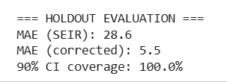
Model Evaluation
Metric: MAE on 20% holdout set
Corrected model MAE < SEIR baseline — gradient boosting layer adds value
90% CI coverage target: ≥90% of holdout actuals fall inside the band
Holdout CI is fixed width (± 1.645 × residual_std) — no horizon scaling
√(weeks ahead) scaling applies only to the forward forecast, not evaluation

Slide 10
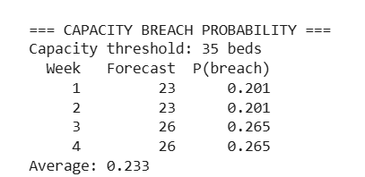
Capacity Breach Probability
Capacity = 75th percentile of hospitalizations over the most recent 52 weeks
P(breach) = normal survival function applied to each forecast week
Bars turn red when P(breach) > 0.5 — the actionable alert threshold
Breach probability uses fixed residual_std — does not compound with horizon
Tiered response: low → monitor; moderate → prepare; high → activate protocols
Notes:
This is where the model becomes a decision support tool. Saying "65% chance hospitalizations exceed your ceiling next week" maps directly onto how administrators make decisions — they act on risk, not point estimates. The 75th percentile capacity proxy should ideally be replaced with actual licensed bed and staffing limits. Known limitation: because residual_std is fixed, P(breach) in W4 is slightly overconfident. Applying √(weeks ahead) scaling here too would be a straightforward production improvement.

Slide 11


Limitations & Model Drift
β is fixed within each wave, so it may miss mid-wave transmission changes
Gradient boosting may overfit pandemic-specific patterns
HHS Protect data is self-reported with known completeness gaps — forecasts inherit those limitations
Notes:
β is fixed within each wave, so it may miss mid-wave transmission changes
Beta is calibrated once per wave period using historical data, so if transmission accelerates or drops mid-wave — due to a new subvariant, a policy change, or a behavioral shift — the model won't pick that up until the next wave boundary. In practice this means forecasts can lag reality during inflection points, which is exactly when accuracy matters most.
Gradient boosting may overfit pandemic-specific patterns
The corrector is trained on residuals from a specific historical period with unique dynamics — lockdowns, vaccine rollouts, variant waves. Patterns it learned may not generalize to future surges that look structurally different. A simpler linear corrector would be more stable across novel regimes, and that's a real tradeoff worth acknowledging if this model were deployed in production.
HHS Protect data is self-reported with known completeness gaps
Hospitals reported voluntarily and at varying frequencies, meaning some weeks have missing or delayed counts that get forward-filled or dropped during preprocessing. If a hospital underreported during a surge — which is plausible given administrative burden during peak periods — the model trains on artificially low numbers and will systematically underestimate future surges. The forecast is only as reliable as the data it was built on.

Slide 12

Ethical Considerations
Forecasts can shape behavior, not just predict it
Errors have unequal costs: overestimates waste resources; underestimates risk lives
Uncertainty must be shown clearly to avoid treating forecasts as certainties
County-level SEIR models can hide disparities across demographic groups
Notes:
Forecasts can shape behavior, not just predict it
A published surge forecast isn't passive — if administrators or the public see a high breach probability, they may change behavior in ways that reduce or amplify the surge itself. That feedback loop means the model can appear wrong even when it was right, and it's why forecast communication requires as much care as forecast accuracy.
Errors have unequal costs: overestimates waste resources; underestimates risk lives
These consequences are not symmetric. Over-forecasting a surge means unnecessary staffing, diverted resources, and alert fatigue. Under-forecasting means patients arrive at an unprepared system. That asymmetry should inform how thresholds are set — when in doubt, the cost structure argues for erring toward earlier warnings rather than later ones.
Uncertainty must be shown clearly to avoid treating forecasts as certainties
A point forecast without context invites false confidence. The 90% prediction intervals exist precisely to communicate what the model doesn't know, not just what it predicts. If a decision-maker only sees the center line and acts on it as a guarantee, the model has done more harm than good regardless of its accuracy.
County-level SEIR models can hide disparities across demographic groups
SEIR treats the entire Dallas County population as a single homogeneous pool. In reality, COVID hit lower-income communities, essential workers, and communities of color harder and earlier. A county average that looks manageable can mask a localized crisis in specific zip codes or demographic groups — and a model that doesn't surface that is giving decision-makers an incomplete picture of who is actually at risk.

Slide 13


Concluding Insights
Per-wave beta calibration + gradient boosting correction outperforms SEIR alone
90% CI achieves near-target holdout coverage
Surge detection provides actionable lead time estimates
Breach probability converts forecasts into an operational risk framework
Notes:
o close: this project demonstrates that combining mechanistic epidemiological models with statistical correction layers is a viable and effective approach to hospitalization surge forecasting. The hybrid model outperforms the SEIR baseline, produces honest uncertainty estimates, and generates actionable risk signals. The most important next steps for a production system are adaptive re-calibration to handle variant drift, a hierarchical structure to handle county-size heterogeneity, and direct integration with hospital operations teams so that the probability outputs map to actual response protocols. Thank you — happy to take questions.

Slide 14

Thank You
COVID-19 Hospitalization Surge Forecasting
Notes:
Today I'll walk you through a hybrid forecasting model built to predict COVID-19 hospitalization surges in Dallas County, Texas.

